Slide 1


PROJECT 16
Weather Proxy API
AI Assisted Coding

Slide 2

TEAM DETAILS:
THOKALA SRIVALLI - 2403A510B2
A.VAMSHI KRISHNA- 2403A510B3
J.RUTHVIK REDDY- 2403A510B5

Slide 3
INTRODUCTION
Uses Node.js Express Proxy API
Fetches live data from OpenWeatherMap
Returns clean JSON to frontend
Secure and fast weather system
Real-time weather web application

Slide 4

PROBLEM STATEMENT
CORS issues occur in browser
Direct API calls expose the API key
API returns huge unformatted JSON
Need secure backend middleware
Need clean data for UI display

Slide 5
OBJECTIVES
Build secure proxy API using Node.js
Protect API key using .env
Reformat JSON response
Build modern weather dashboard
Provide accurate live weather

Slide 6
STAKEHOLDERS
● Project Team
● Developers
● End Users
● OpenWeather API Data Providers
● Educational Institution / Faculty Mentors

Slide 7
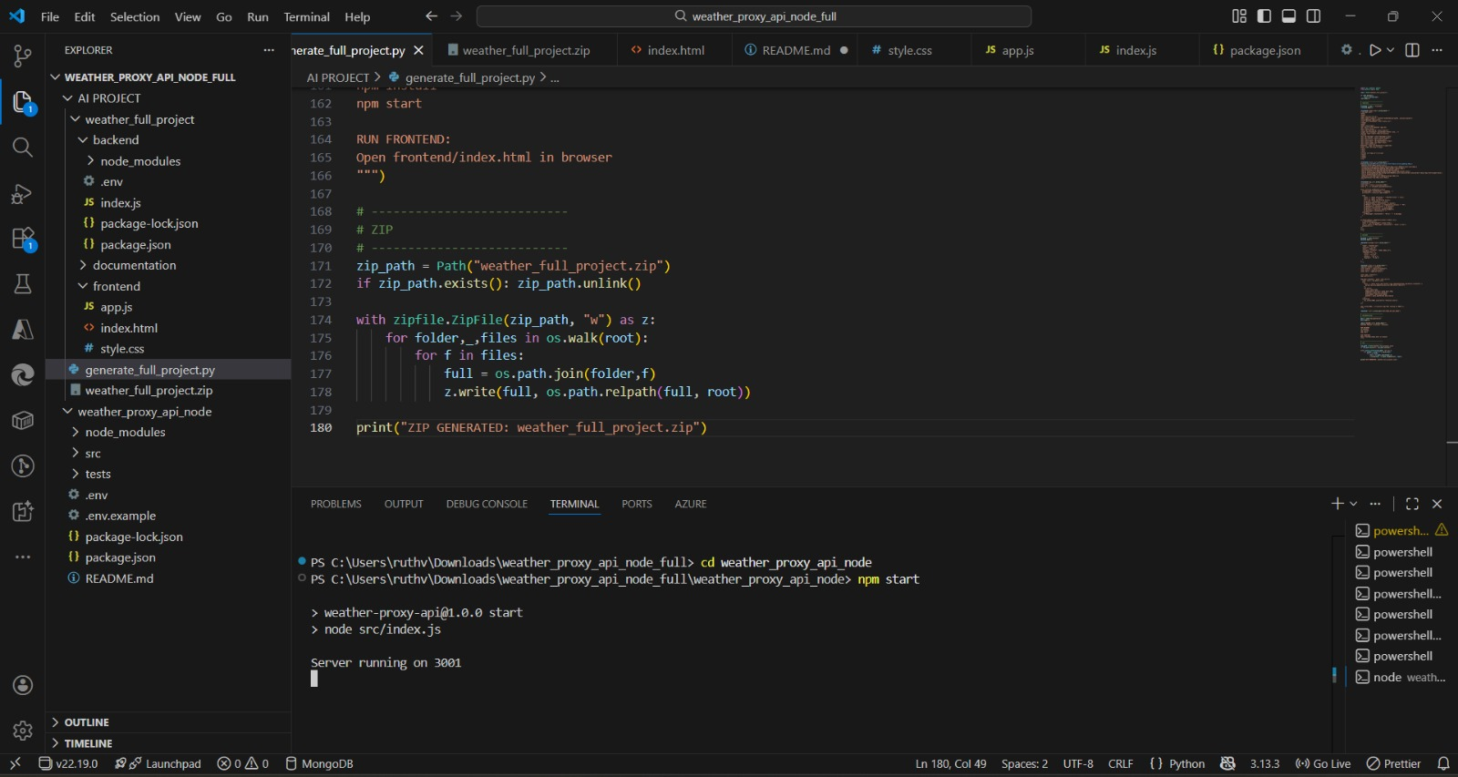
TECHNOLOGIES USED
Backend:
Node.js
Express.js
Axios
dotenv
Frontend:
HTML
CSS
JavaScript
API:
OpenWeatherMap

Slide 8

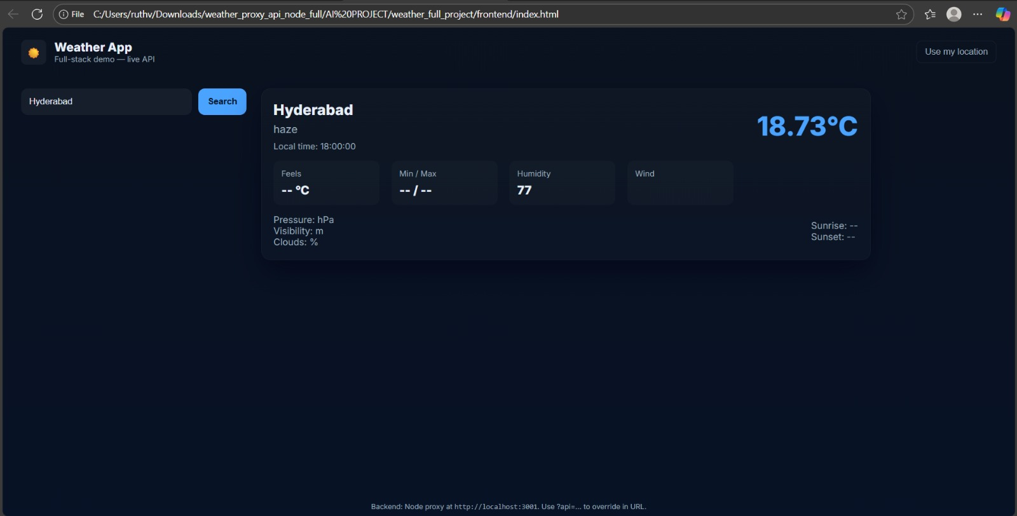
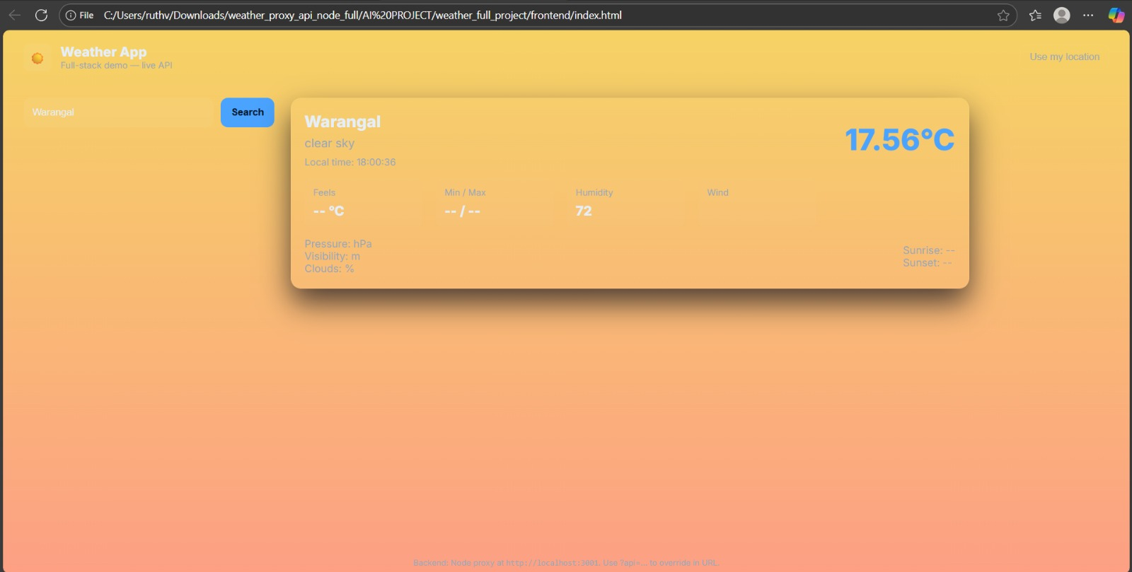
FRONT-END VIEW (API INTERFACE)
Search by city
Displays temperature
Humidity, wind speed, clouds
Weather icons and description
Fully responsive design
Modern weather dashboard UI

Slide 9
SOFTWARE APPLICATION
● Fetches live weather data securely
● Processes and cleans raw API response
● Converts data into simplified JSON output
● Acts as a secure and optimized weather data proxy
● Helps other client apps consume weather info easily

Slide 10
CODE OVERVIEW
main.py – Initializes FastAPI app
weather_service.py – Contains logic to call OpenWeather API
models.py – Pydantic models for validation
config.py – API keys & configuration
Purpose of Code:
● Implement routing
● Manage API requests
● Ensure clean structured output

Slide 11

AI TOOLS USED
● ChatGPT for code generation
● AI-assisted debugging
● AI-powered documentation
● AI guidance for API flow design
● AI-supported error solving & optimization

